Slide 1
Taxes

Slide 2
Luis Connolly, Financial Coach International Rescue Committee

Slide 3
Objectives
What are taxes?
Types of taxes
The W-4 Form
The 1099 Form
Child Tax Credit
ITIN
W-7
How can you file your taxes?
Notes:
We will start by talking about the Pause on Rent in NYC and what it means for you. Then we will look at how you should change your budget during this emergency including how to communicate with you landlord if you are not able to Pay rent. Then we will look at what are the financial supports that exist that you can use. Lastly we will talk about how to deal with debt this means if you have money you owe, how are dealing with that during this time.
Any Questions

Slide 4
Understanding Taxes

Slide 5
What are Taxes?
Did you pay taxes back home in your country?
What do taxes pay for?
What types of taxes do you pay?
Notes:
It has been extended until August 20th; you can use your direct deposit to pay for your rent and the money you owe. You have to start paying back that deposit 3 months after you use it to pay for rent. You can pay it back little by little. You can divide your deposit by 12 and pay back that partition every month.
You cannot be charged late fees. This 2 months extension applies to those who have faced financial difficulties due to COVID 19 or are receiving UI or other federal or state benefits.

Slide 6
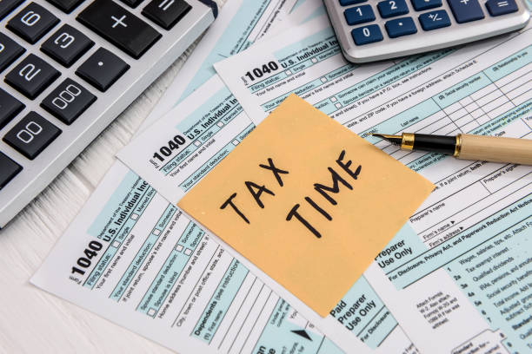
What are Taxes?
Taxes are required payments by both individuals and corporations to the federal, state and local governments

Slide 7
Why is it important to pay Taxes?
Economic Growth
Finance government programs
Support common resources
Immigration applications

Slide 8
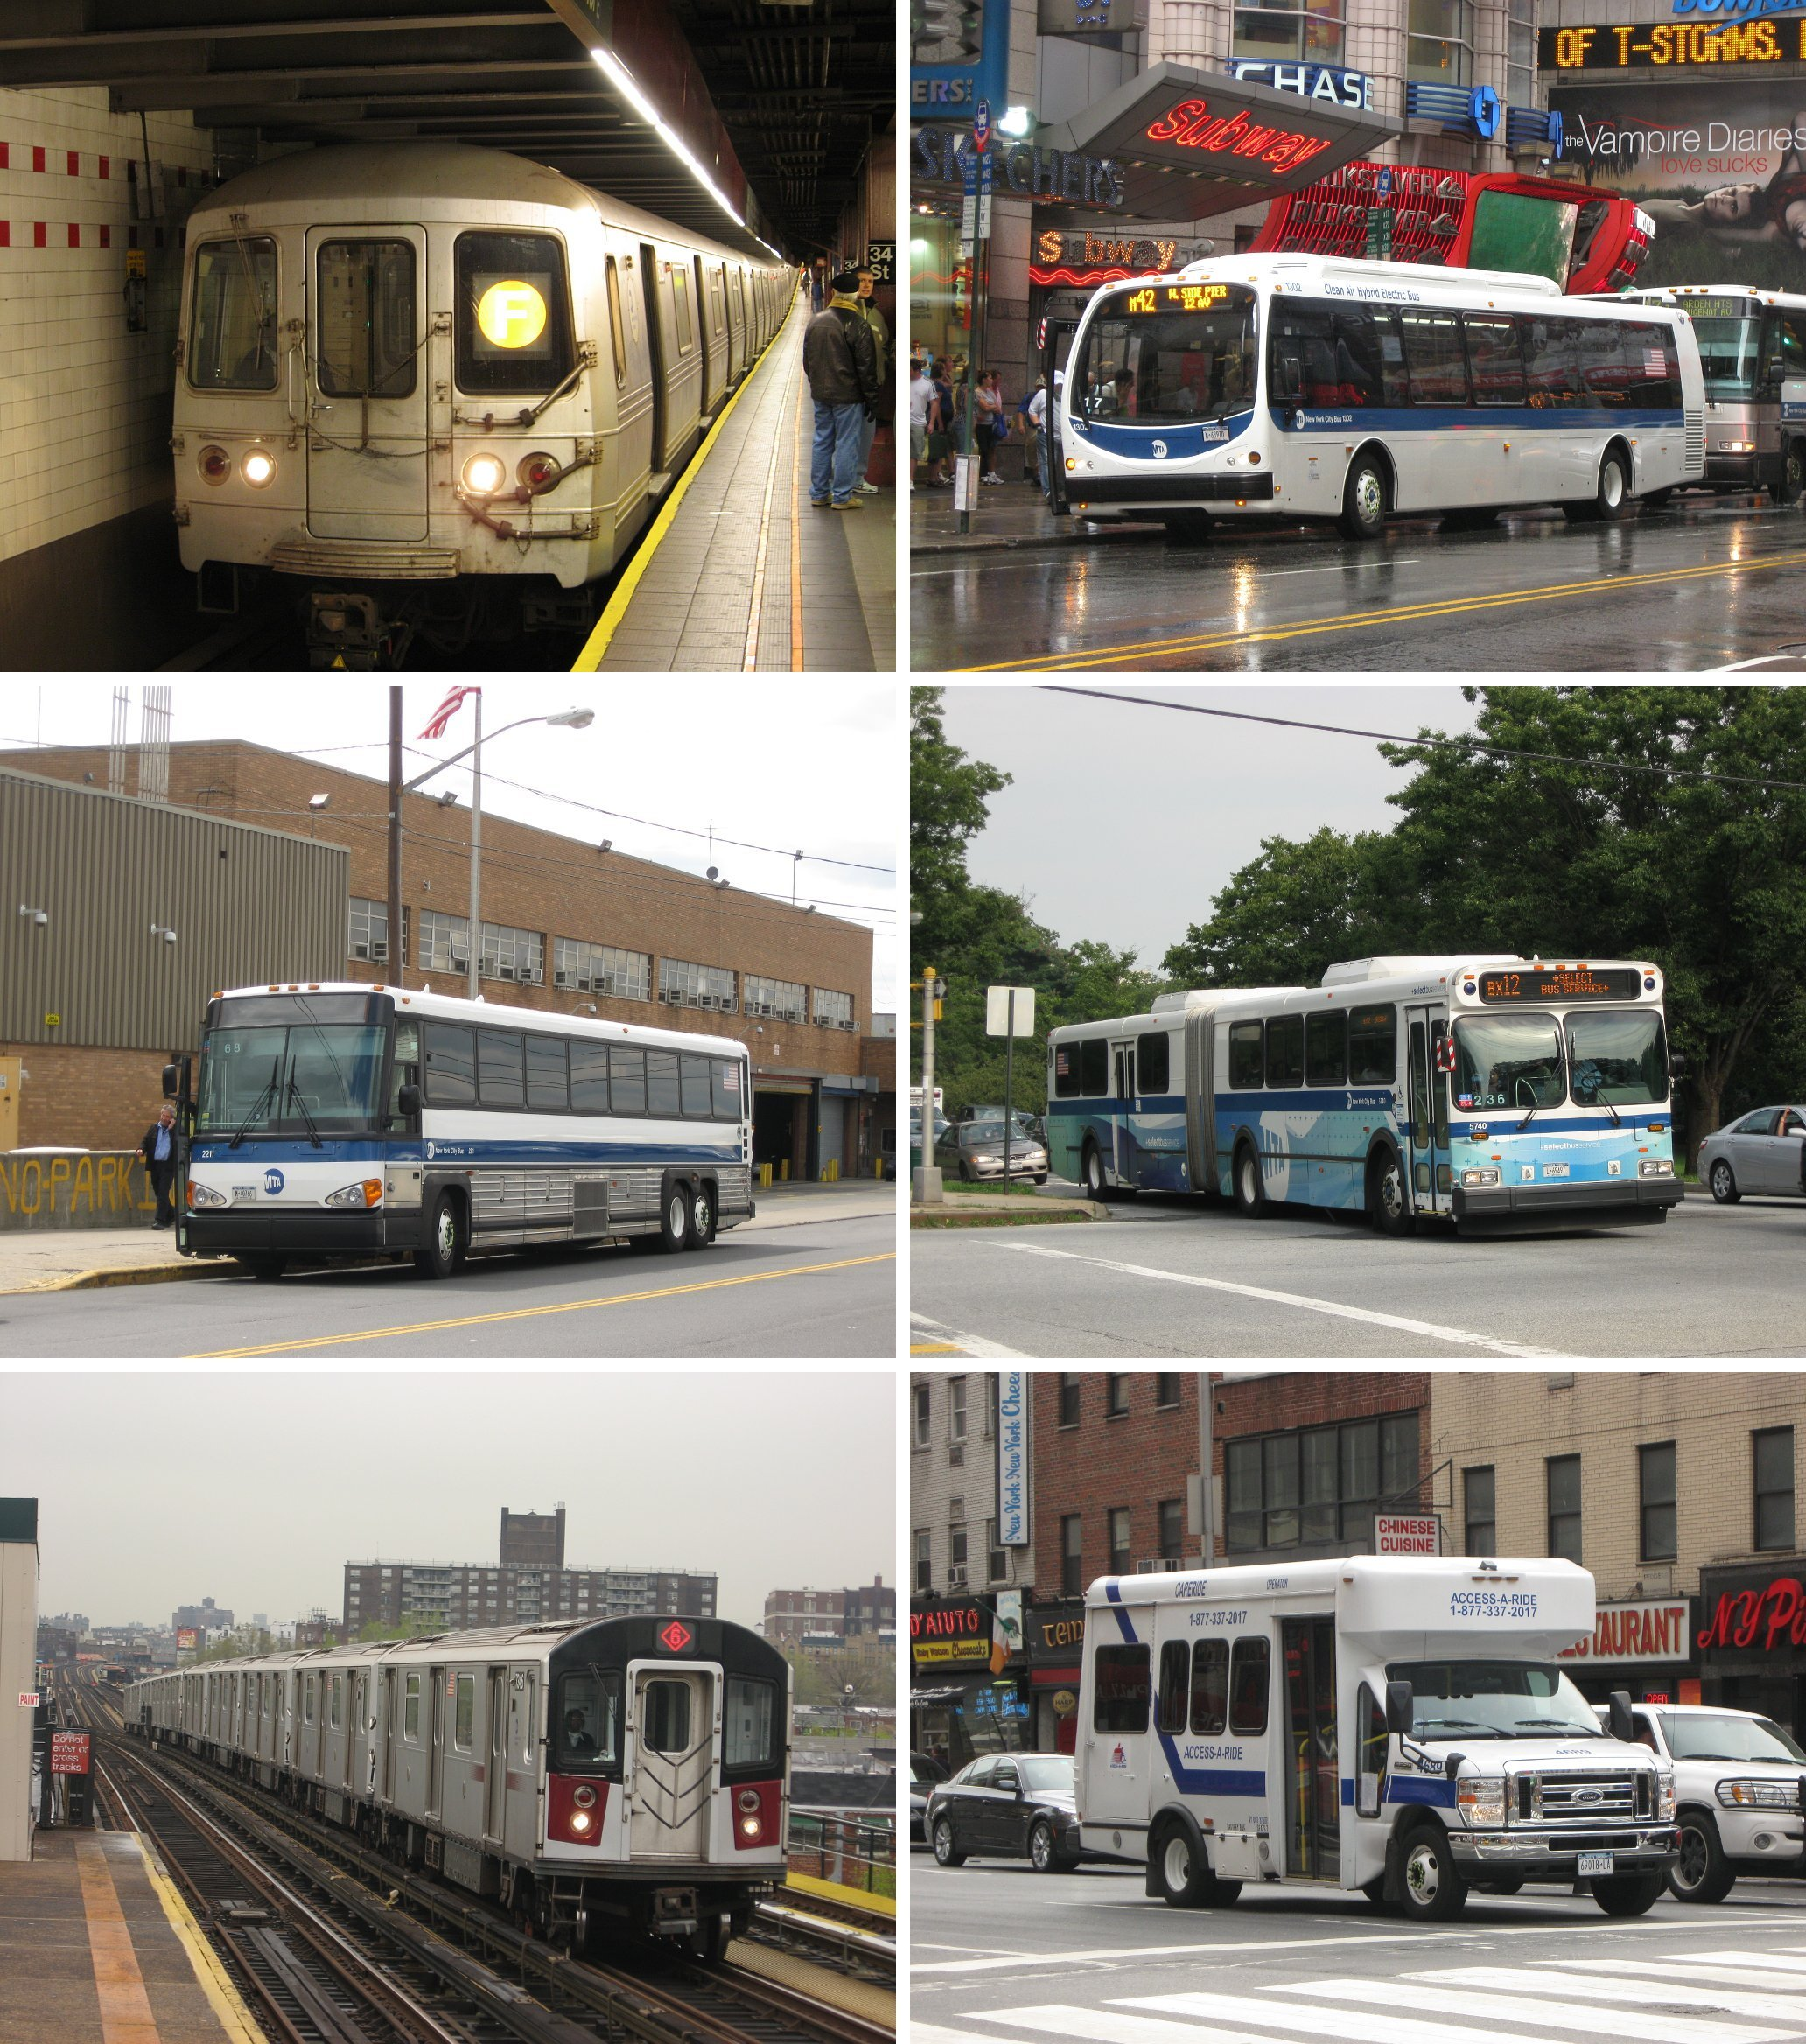
Where do our Taxes go?
Public libraries and parks.
Roads
Fire Department
Police
Transportation
Medicaid/Medicare
Veteran's benefits
Education

Slide 9
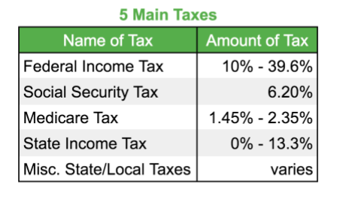
Types of Taxes
Income Tax
Social Security Tax
Medicare Tax
Property Tax
Consumption/Sales Tax
Federal vs. State vs. Local/NYC

Slide 10
How do I pay taxes?
From your job
Payroll employee- from paycheck
Non-Payroll- pay separately
When you buy things at the store

Slide 11
Payroll Employees-W4 Form
This form determines how much the employer will take from your paycheck for taxes.
Filling out the form
https://www.irs.gov/pub/irs-pdf/fw4.pdf

Slide 12
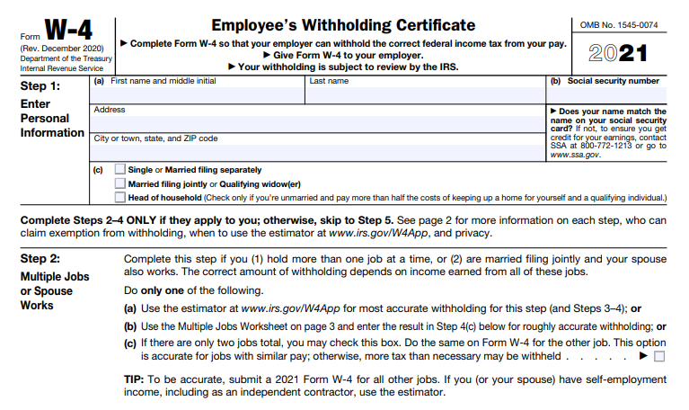
W4 form – Part 1 and 2

Slide 13
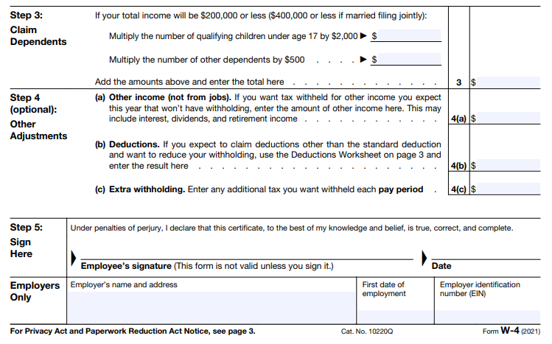
W4 form – Part 3 and 4

Slide 14
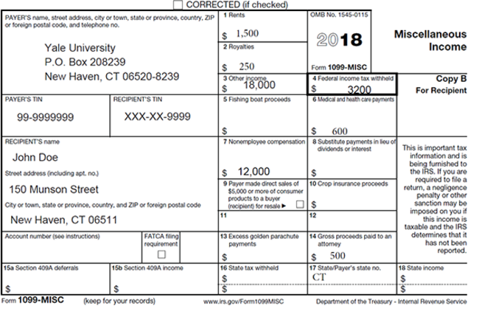
Non-Payroll Employees-1099 Form
Complete form if you are paid as contractor or paid cash
Can file taxes quarterly or end of year
Tax Calculator

Slide 15
Filing your Taxes

Slide 16
Tax Filing deadline
January-mid-April people in the US must submit their tax information to the IRS. Basically this is a way for the government to see if you paid the taxes you were supposed to. Sometimes you may have to pay money back or you might get some money!
Notes:
Every year from January-mid-April people in the US must submit their tax information to the IRS. Basically this is a way for the government to see if you paid the taxes you were supposed to. Sometimes you may have to pay money back or you might get some money!

Slide 17
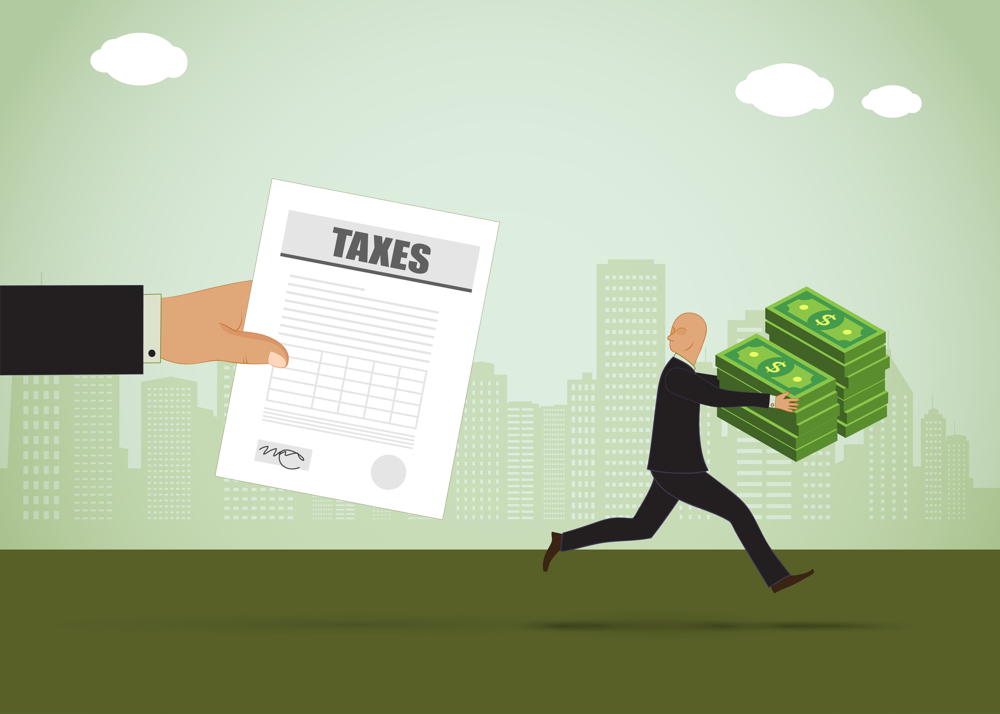
Who should file taxes?
If you are under 65 and have an income of $12,550 or more
Income can include: Work, Unemployment, Social Security
Does not include Public benefits
If your self-employed income is at least $400
All cash income needs to be reported
You might be eligible for refund or credits!

Slide 18
Asylum Seekers: Should you file taxes?
If you had income....Yes!
Resident aliens must follow the same tax laws as U.S. citizens.

Slide 19
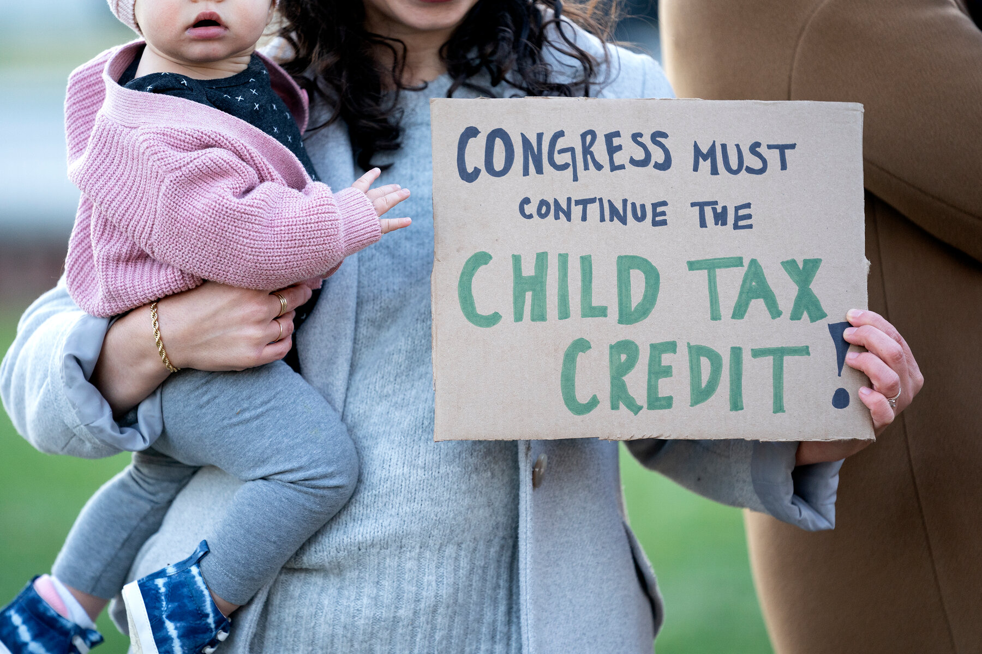
Child Tax Credit (CTC)
The child tax credit is a tax benefit granted to American taxpayers for each qualifying dependent (child).
Refundable vs. Non-Refundable
How much is the credit?
$3,600 for children 5 and under
$3,000 for children 6 to 17
How do I get it?
File your taxes!
Am I eligible?

Slide 20
Child Tax Credit Eligibility
Qualifying child- Under 18, lived with you half the year
Main home in the US for at least half the year
Below $75,000 if you are single or $150,000 if Married filing jointly
Filed taxes or provided information to the IRS

Slide 21
CTC – Refundable vs Non-Refundable credit example
You owe $2000 in taxes
You have a credit of $2500
If the credit is non-refundable, only $2000 will be used to pay for your tax bill and you don’t get the remaining $500 as a refund
If your credit is refundable, you will get the $500

Slide 22
Advance child tax credit
If you received Advance CTC last year you must bring letter 6419.
Letter can be received on the mail
Accessible online
https://www.irs.gov/payments/your-online-account

Slide 23
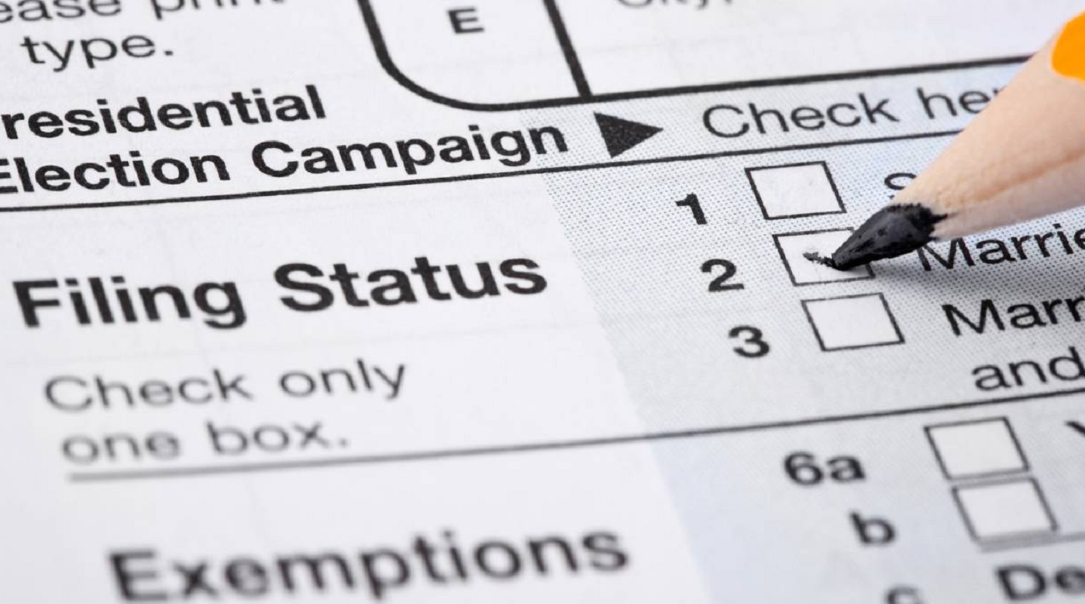
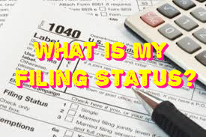
Filing Status
Determines the rate at which your income is taxed.
How many filing status are there? Let's find out!

Slide 24
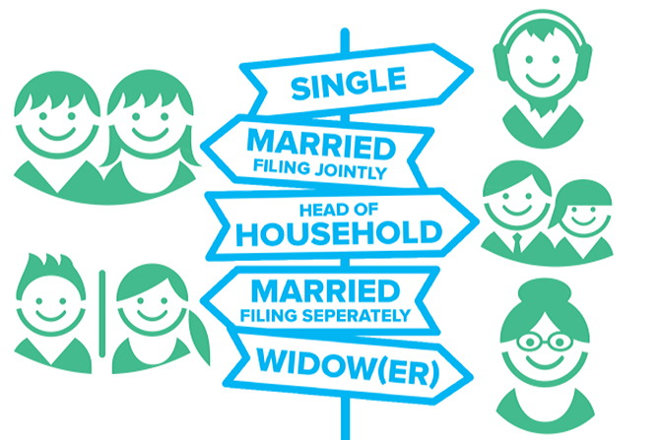
Filing Status
Single
Married filing jointly
Married filing separately
Head of household
Qualifying widow(er) with dependent child

Slide 25
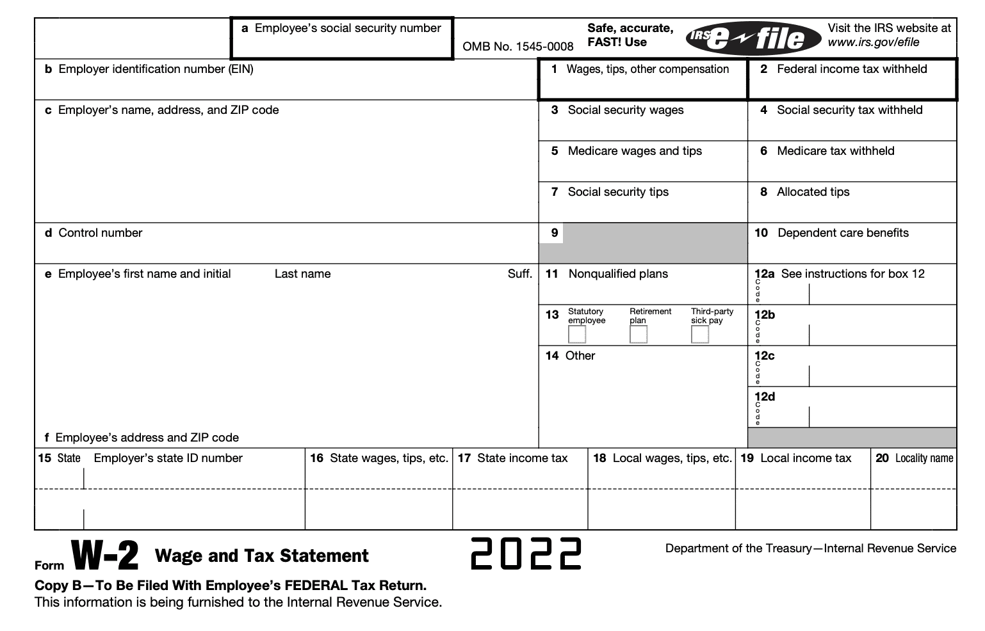
What documents do I need to bring?
Social security number or tax ID number
Your spouse’s full name, social security number or tax ID number, and date of birth
Social security for dependents if you have any
Tax papers (W-2, 1099G, SSA-1099..)
IRS Letter 6475
Routing and account numbers

Slide 26
How To File Your Taxes
Free filing at IRS.gov/freefile
IRC - VITA
Free NYC Tax Prep
In-person
Virtual tax preparation
Paid professionals at places such as H&R Block

Slide 27
What is an ITIN ?
The ITIN or Individual Taxpayer Identification Number is a tax processing number only available for certain non-resident and resident alien.

Slide 28
Differences between SSN and ITIN
Social Security
ITIN

Slide 29
How to apply for an ITIN?
You can file Form W-7
You can also use this form to renew an existing ITIN that is expiring or that has already expired.

Slide 30
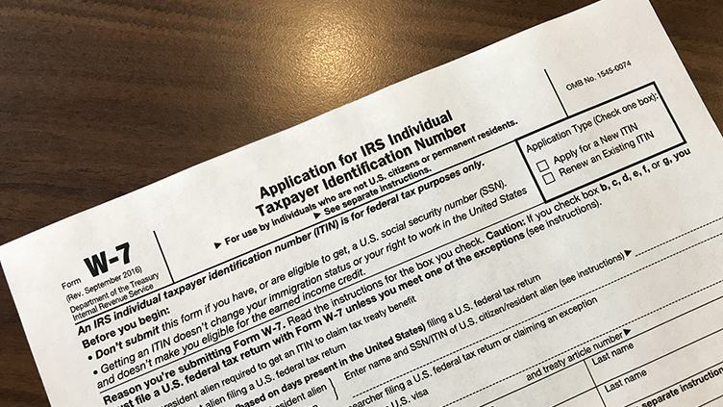
Form W-7 asks for the following information:
Reason for ITIN
Name and Address
Birth Date
Country of Citizenship
Foreign tax ID number (if you have it)
U.S. visa number (if you have it)
Identity documents

Slide 31
Where to apply?
Mail your W-7, tax return, proof of identity, and foreign status documents to: International Revenue Service
Apply for an ITIN in-person using the services of an IRS-authorized Certifying Acceptance Agent. This will prevent you from having to mail your proof of identity and foreign status documents.
Or Make an appointment at a designated IRS Taxpayer Assistance Center
After processing, the IRS will issue your ITIN through the mail.

Slide 32
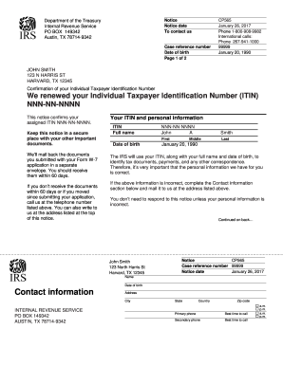
How long does it take?
You will receive a letter from the IRS assigning your tax identification number usually within seven weeks if you qualify for an ITIN and your application is complete.

Slide 33
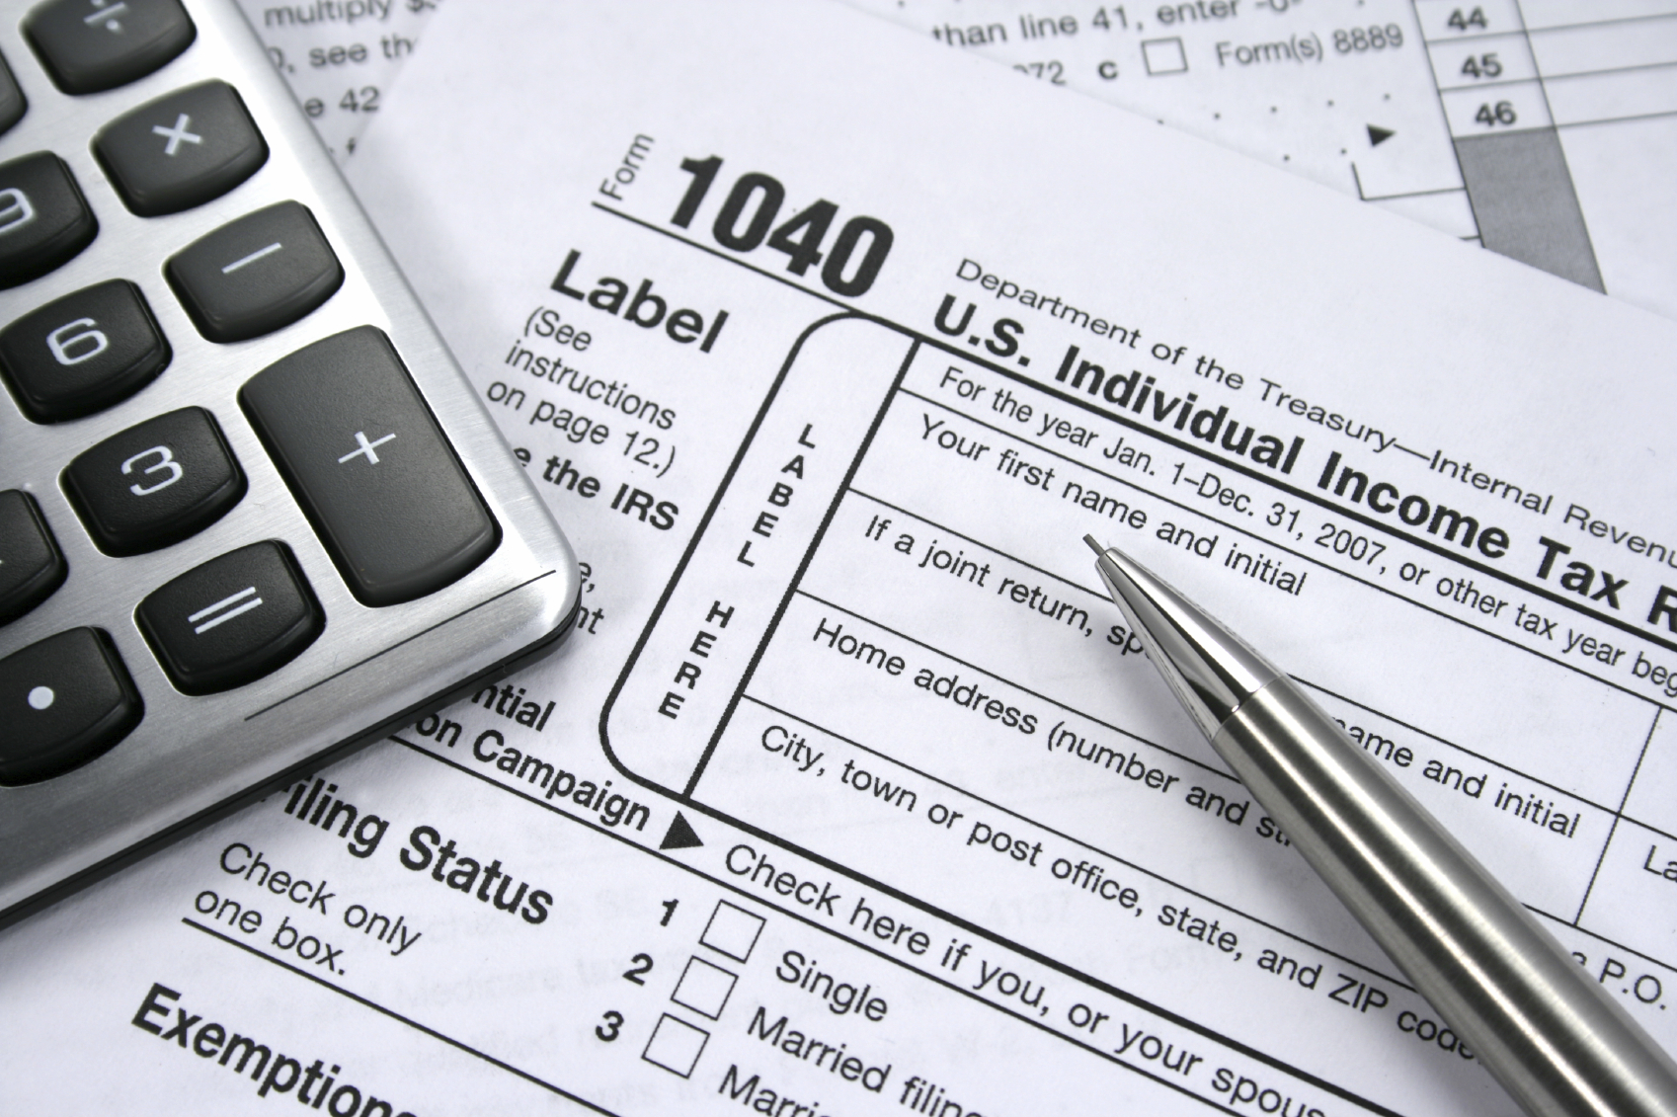
Summary-What did we learn today?
Taxes are required payments by both individuals and
corporations to the federal, state and local governments
Taxes are mandatory
There are 5 filing statuses
There are different types of taxes
We should file taxes in the end of the year
Don't forget to bring your SS, ID card, and tax forms when
preparing taxes
SSN and ITN are not the same
There are specific requirements to be eligible for child tax credit

Slide 34
IRC Financial Services
Financial Classes
Financial Coaching
Free Tax Preparation
Small Loans
Get in contact with us!
Luis.AraqueConnolly@rescue.org
+1 (212)-377-4757

Slide 35
Questions?

